Slide 1
INTEL UNNATI Industrial Training Program Project Report (Code Crusaders)
Faculty Mentor: dr. Narendra patel
Member 1 : Priyansh Kalathil priyanshshajan03@gmail.com
Member 2 : zoha surti zohasurti2004@gmail.com
Member 3 : Dhriti shah dhriti180503@gmail.com

Slide 2
Problem Statement : 16
Running GenAI on Intel AI Laptops and Simple LLM Inference on CPU and fine-tuning of LLM Models using Intel® OpenVINO™
Description
This problem statement is designed to introduce beginners to the exciting field of Generative Artificial Intelligence (GenAI) through a series of hands-on exercises. Participants will learn the basics of GenAI, perform simple Large Language Model (LLM) inference on a CPU, and explore the process of fine-tuning an LLM model to create a custom Chatbot.

Slide 3
Unique Idea Brief (Solution)
Problem Context
In today's fast-paced world, maintaining a healthy lifestyle and fitness regimen is a priority for many. However, access to personalized fitness advice can be challenging. Traditional methods, such as consulting with personal trainers or searching for information online, often fall short due to the following issues:
Personal trainers can be expensive and not accessible to everyone.
Online information is abundant but can be overwhelming, contradictory, or inaccurate.
People may not have the time to sift through extensive resources to find relevant fitness advice.
These challenges highlight the need for an efficient, accessible, and personalized solution to provide reliable fitness guidance.

Slide 4
Unique Idea Brief (Solution)
Solution Offered
To address these challenges, we have developed an intelligent chatbot designed to provide users with accurate, personalized fitness-related answers. Here’s how our solution stands out:
The chatbot is available 24/7, making it easy for users to access fitness advice anytime, anywhere.
Users can quickly get answers to their specific fitness questions without having to spend time searching through vast amounts of information.
The chatbot is designed to be intuitive and easy to use, providing a seamless user experience.
In conclusion, our fitness chatbot bridges the gap between accessibility and personalized fitness guidance, making it easier for individuals to achieve their health and fitness goals efficiently and effectively.

Slide 5
Features Offered
24/7 Availability
Provide responses to common fitness-related questions.
Provide pre-defined exercise routines for different fitness goals (e.g., weight loss, muscle gain, flexibility).
Provide simple dietary suggestions to complement fitness routines.
Natural Language Processing (NLP)

Slide 6
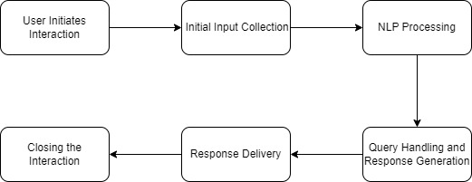
Process Flow

Slide 7
Technologies Used
Pre-trained models used: distilgpt2
Python libraries used: PyTorch, Transformers, pandas, sentencepiece
Dataset used: HazSylvia/Fitness_Unformatted
Intel software used: OpenVINO
Front-end software: Gradio
Platform for creating model: Google Colab
Platform for deploying model: HuggingFace

Slide 8
Team members and contributions
Priyansh Kalathil
Conducted research study on the fine tuning process.
Created the repository for the project
Push the model to the repository
Documented the work and report for the project

Slide 9
Team members and contributions
Zoha Surti
Conducted research and study on various large language models (LLMs).
Gained expertise in using Hugging Face to identify optimal datasets.
Acquired knowledge of the OpenVINO toolkit and utilized the Optimum Intel library for efficient inference of LLMs.
Developed the frontend of the chatbot using Gradio and successfully deployed it on Hugging Face Spaces.

Slide 10
Team members and contributions
Dhriti Shah
Conducted research and development using Hugging Face libraries to understand and implement various large language models (LLMs).
Gained knowledge regarding the OpenVINO toolkit ,optimum library and streamlit.
Utilized Google Colab for developing and testing machine learning models.
Fine-tuned the distilGPT-2 model and trained it on a custom fitness dataset to enhance its performance for domain-specific tasks.

Slide 11
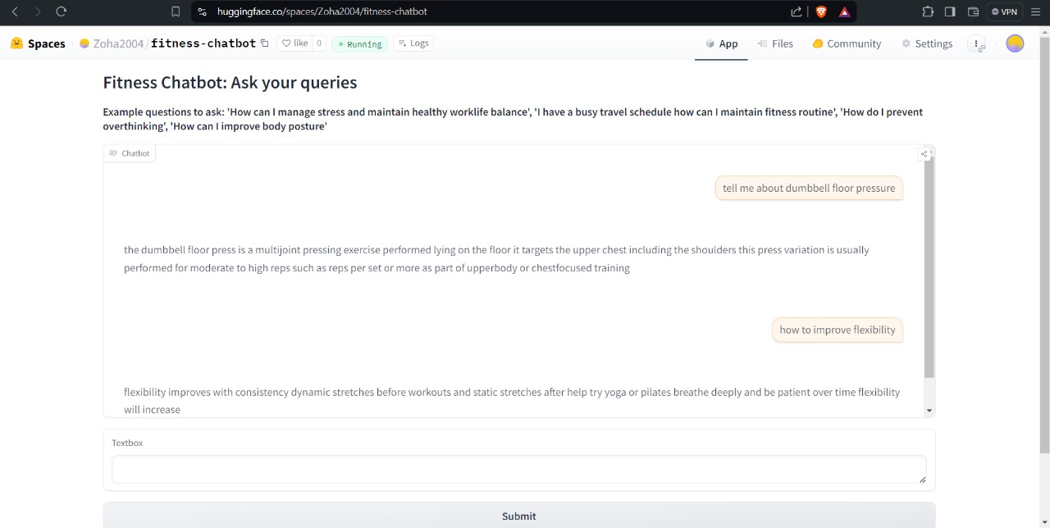
Project Snapshots

Slide 12
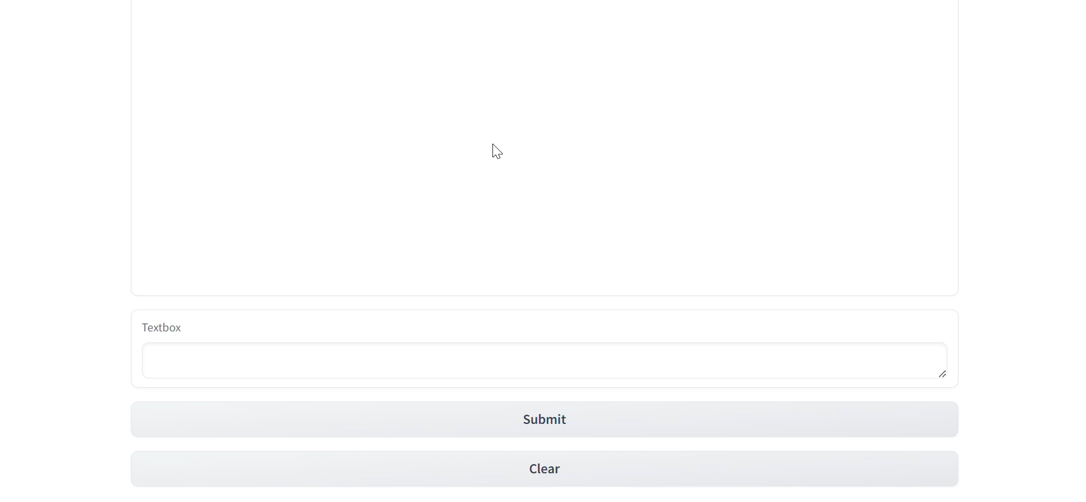
Video

Slide 13
Conclusion
Successfully learnt the basics of GenAI, performed simple Large Language Model (LLM) inference on a CPU, and explored the process of fine-tuning an LLM model using Intel® OpenVINO™ to create a custom Chatbot.
Note: The dataset used was very small. So it may result in some inaccuracies in the inference.

Slide 14
Project Link
Model: https://huggingface.co/DhritiShah/fitnessmodel
HuggingFace: https://huggingface.co/spaces/Zoha2004/fitness-chatbot
Github: https://github.com/Priyansh-S-K/Intel_GenAI_Project
Model Demo: Drive Link

Slide 15
Thank You

